Slide 1
SONET
Synchronous Optical Network

Slide 2
Telephone Networks {Brief History}
Digital carrier systems
  The hierarchy of digital signals that the telephone network uses.
  Trunks and access links organized in DS (digital signal) hierarchy
  Problem: rates are not multiples of each other.
In the 1980’s Bellcore developed the Synchronous Optical Network (SONET) standard.
Previous efforts include: ISDN and BISDN.

Slide 3
North American Digital Hierarchy
Primary
Multiplex
Eg. Digital
Switch
24 chan PCM
M12
Multiplex
x4
M23
Multiplex
x7
DS1 1.544 Mbps
DS2 6.312 Mbps
DS3 44.736 Mbps
1
M13
Multiplex
DS3 44.736 Mbps
●
●
●
28
European Digital Hierarchy
Primary
Multiplex
Eg. Digital
Switch
30 chan PCM
CEPT 1
3rd order
Multiplex
x4
2.048 Mbps
2nd order
Multiplex
x4
8.448 Mbps
34.368 Mbps
4th order
Multiplex
x4
CEPT 4
139.264 Mbps
Copyright ©2000 The McGraw Hill Companies
Leon-Garcia & Widjaja: Communication Networks
Figure 4.5

Slide 4
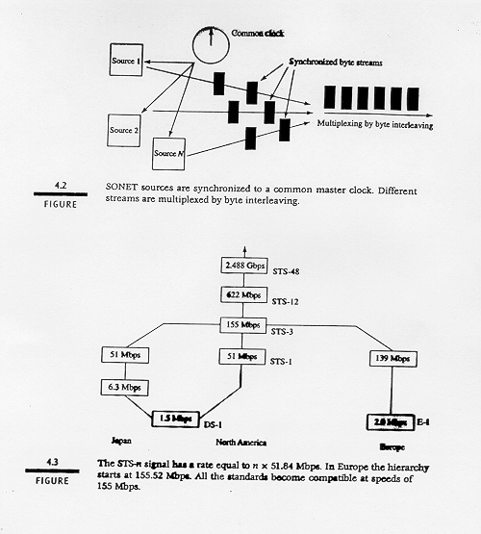

Slide 5
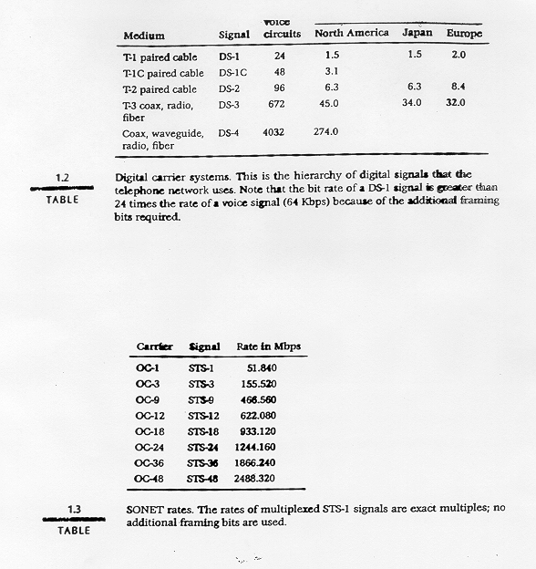

Slide 6
SONET
Transmission links of the telephone network have been changing to SONET where rates are arranged in STS (Synchronous Transfer Signal) hierarchy.
The hierarchy is called SDH (Synchronous Digital Hierarchy) defined by CCITT.
It is an ITU standard.

Slide 7
SONET
SONET:: encodes bit streams into optical signals propagated over optical fiber. SONET defines a technology for carrying many signals of different capacities through a synchronous, flexible, optical hierarchy.
A bit-way implementation providing end-to-end transport of bit streams.
All clocks in the network are locked to a common master clock so that simple TDM can be used.
Multiplexing done by byte interleaving.
SONET is backward compatible to DS-1 and E-1 and forward compatible to ATM cells.
Demultiplexing is easy.

Slide 8
DS1
Low-Speed
Mapping
Function
DS2
STS-1
CEPT-1
51.84 Mbps
DS3
Medium
Speed
Mapping
Function
STS-1
44.736
●
●
●
●
●
●
STS-n
OC-n
STS-3c
CEPT-4
High-
Speed
Mapping
Function
STS-1
Mux
Scrambler
E/O
STS-1
139.264
STS-1
STS-1
STS-3c
High-
Speed
Mapping
Function
STS-1
ATM
STS-1
150 Mbps
Copyright ©2000 The McGraw Hill Companies
Leon-Garcia & Widjaja: Communication Networks
Figure 4.8

Slide 9
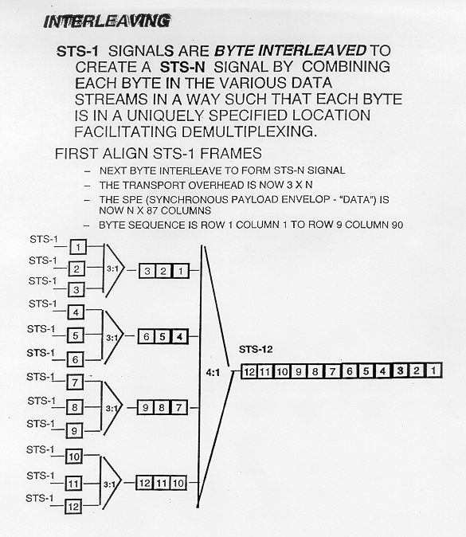

Slide 10
SONET Architecture
SONET topology can be a mesh, but most often it is a dual ring.
Standard component of SONET ring is an ADM (Add/Drop Multiplexer)
  Drop one incoming multiplexed stream and replace it with another stream.
  Used to make up bi-directional line switching rings.

Slide 11
a
a
ADM
d
ADM
ADM
b
d
b
ADM
c
c
(a) Dual ring
(b) Loop-around in response to fault
Copyright ©2000 The McGraw Hill Companies
Leon-Garcia & Widjaja: Communication Networks
Figure 4.12

Slide 12
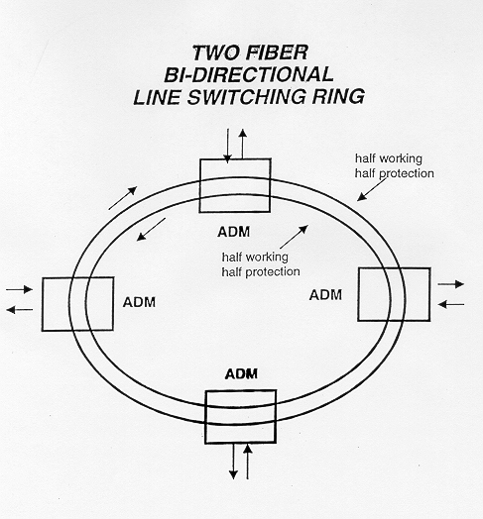
SONET Ring

Slide 13
(a) pre-SONET multiplexing
MUX
DEMUX
MUX
DEMUX
remove
tributary
insert
tributary
(b) SONET Add-Drop multiplexing
MUX
ADM
DEMUX
remove
tributary
insert
tributary
Copyright ©2000 The McGraw Hill Companies
Leon-Garcia & Widjaja: Communication Networks
Figure 4.9

Slide 14
a
OC-3n
OC-3n
b
3 ADMs
c
OC-3n
physical loop net
Copyright ©2000 The McGraw Hill Companies
Leon-Garcia & Widjaja: Communication Networks
Figure 4.10

Slide 15
Regional
Ring
Metro
Ring
Inter-Office
Rings
Copyright ©2000 The McGraw Hill Companies
Leon-Garcia & Widjaja: Communication Networks
Figure 4.13

Slide 16
SONET Architecture
(a)
STS
PTE
STS
PTE
SONET
Terminal
LTE
LTE
SONET
Terminal
STE
STE
STE
Mux
Mux
reg
reg
reg
Section
Section
STS Line
STS-1 Path
STE: Section Terminating Equipment, e.g. a repeater
LTE: Line Terminating Equipment, e.g. a STS-1 to STS-3 multiplexer
PTE: Path Terminating Equipment, e.g. an STS-1 multiplexer
(b)
path
path
line
line
line
line
section
section
section
section
section
section
section
optical
optical
optical
optical
optical
optical
optical
Copyright ©2000 The McGraw Hill Companies
Leon-Garcia & Widjaja: Communication Networks
Figure 4.14

Slide 17
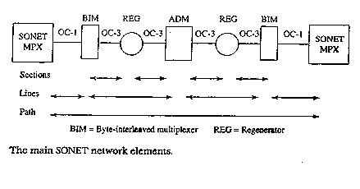

Slide 18
Mux
= BIM (Byte Interleaved Multiplexer)
Reg
= Regenerator
Boosters power of optical signal
  Optical signal converted to electrical signal
  Amplify electrical signal
  Amplifed electrical signal converted back to optical signal

Slide 19
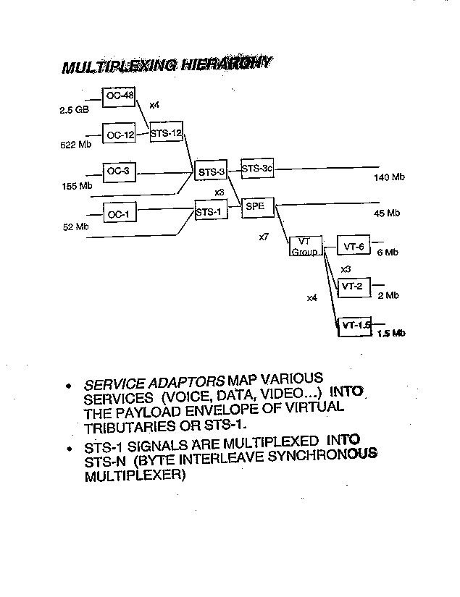

Slide 20
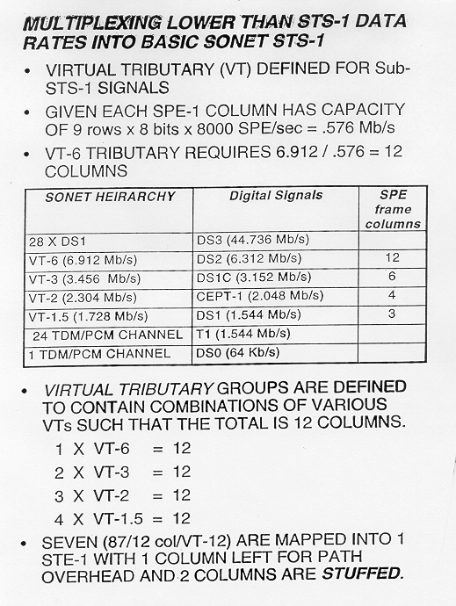

Slide 21
SONET frame
90 bytes
B
B
B
87B
Section
Overhead
3 rows
Information
Payload
9 Rows
Line
Overhead
6 rows
Transport
overhead
125 μs
SPE Synchronous Payload Envelope
Copyright ©2000 The McGraw Hill Companies
Leon-Garcia & Widjaja: Communication Networks
Figure 4.15

Slide 22
SPE straddling SONET frame
Pointer
first octet
frame
k
87 columns
Synchronous
Payload
Envelope
9
rows
Pointer
last octet
frame
k+1
first column is path overhead
Copyright ©2000 The McGraw Hill Companies
Leon-Garcia & Widjaja: Communication Networks
Figure 4.16

Slide 23
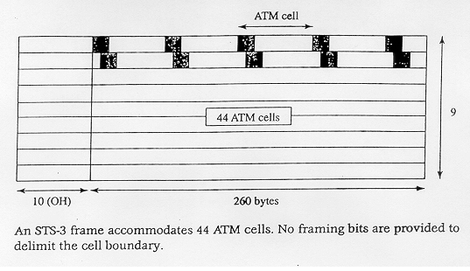
ATM Cells in an STS-3 Frame

Slide 24
STS-1
STS-1
Map
STS-1
STS-1
STS-1
STS-1
STS-1
STS-1
Byte
Interleave
STS-3
Map
STS-1
STS-1
Map
STS-1
STS-1
Incoming
STS-1 Frames
Synchronized New
STS-1 Frames
Copyright ©2000 The McGraw Hill Companies
Leon-Garcia & Widjaja: Communication Networks
Figure 4.17

